Slide 1
New & Emerging Technologies in FR and Intumescent Polymer Compounds
Edward C. Gregor
Managing Director
Edward C. Gregor & Associates, LLC

Slide 2


New & Emerging Technology

Slide 3
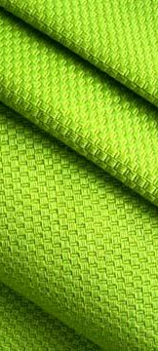
Flexible PVC. One Of The
Most Versatile And Useful
Plastics Made Today.
3rd Largest Volume Thermoplastic Globally
    Cross-Head Extruded Yarns
    (Roller Shades)
    Coated Fabrics (Billboards, Banners, Tents, etc.)
    Contact Fabrics (Wall Coverings, Resilient Flooring, Curtains)
    Truck, Auto, Camper Interiors (Seating, Dashboard, Door Panels, Headliners, etc.
    Pond & Swimming Pool Liners/Shower Curtains
    Children’s Bedding, Cribs, Toys, Pacifiers

Slide 4

Flexible PVC:
Impact On Health
Arguably, Flexible PVC is One of The
Most Toxic
    – Phthalates, Heavy Metals, Vinyl Chloride, Halogens, Dioxins
Center for Health, Environment and
Justice Calls PVC: “The Poison Plastic”
  – Campaign to eliminate it’s use in nurseries,
  schools, elsewhere where children are present
US Government Consumer Product
Safety Commission
  – Banned 6 largest volume plasticizers used in
  flexible PVC in children's bedding, cribs,
  car seats effective Winter of 2010
National, State, Local Governments
  – Germany, Sweden, Spain - Now European Union
  – Boston, Buffalo, NYC, San Francisco, Seattle, etc.
  – Kaiser Permanente’s Hospitals

Slide 5
20th Century 21st Century Opportunity
Sustainable Sustainable Health Personal well-being
PVC Non-toxic Clean products
“Poison Plastic” replacement
“Are you green?” Conscious of Build trust and processes transparency
Commodity Innovation driven Brand advantage
pricing value propositions and differentiation
for “brand-owner”

Slide 6



























Elimination of PVC in products or packaging

Slide 7
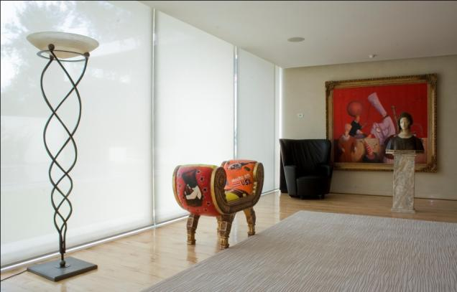
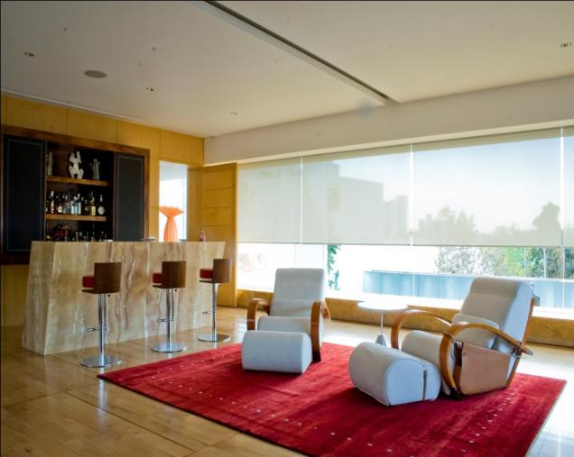
Alternative Compounds to Replace PVC
in a Variety of Applications
No Phthalates, Heavy Metals
or detectable halogens/bromines during combustion, extremely low smoke density & VOC’s
Processable on same
extrusion equipment as PVC
and other Thermoplastics
Cradle to Cradle recyclable
for targeted constructions
Used with Permission: Window roller shades with
Phifer Incorporated's SheerWeave Infinity fabric.

Slide 8
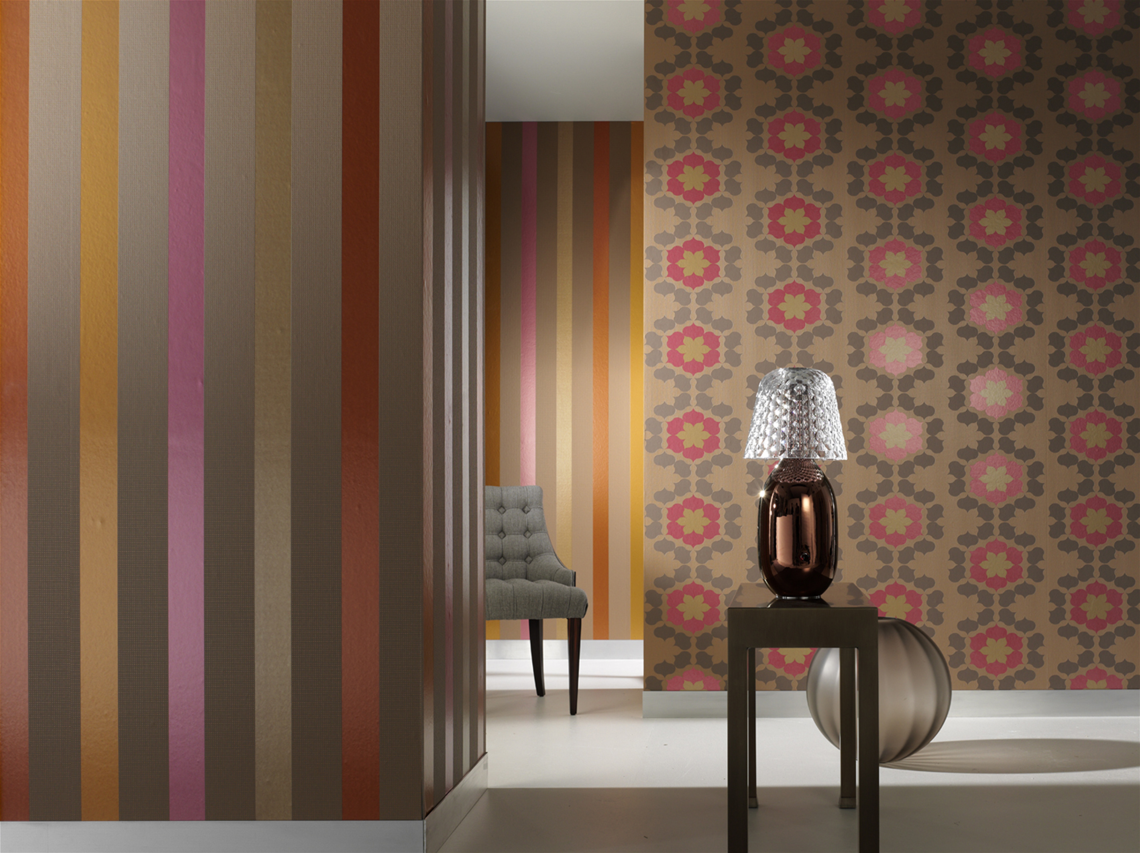
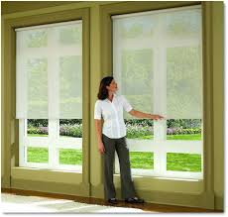
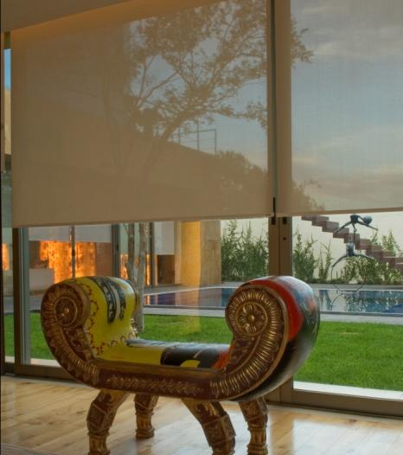
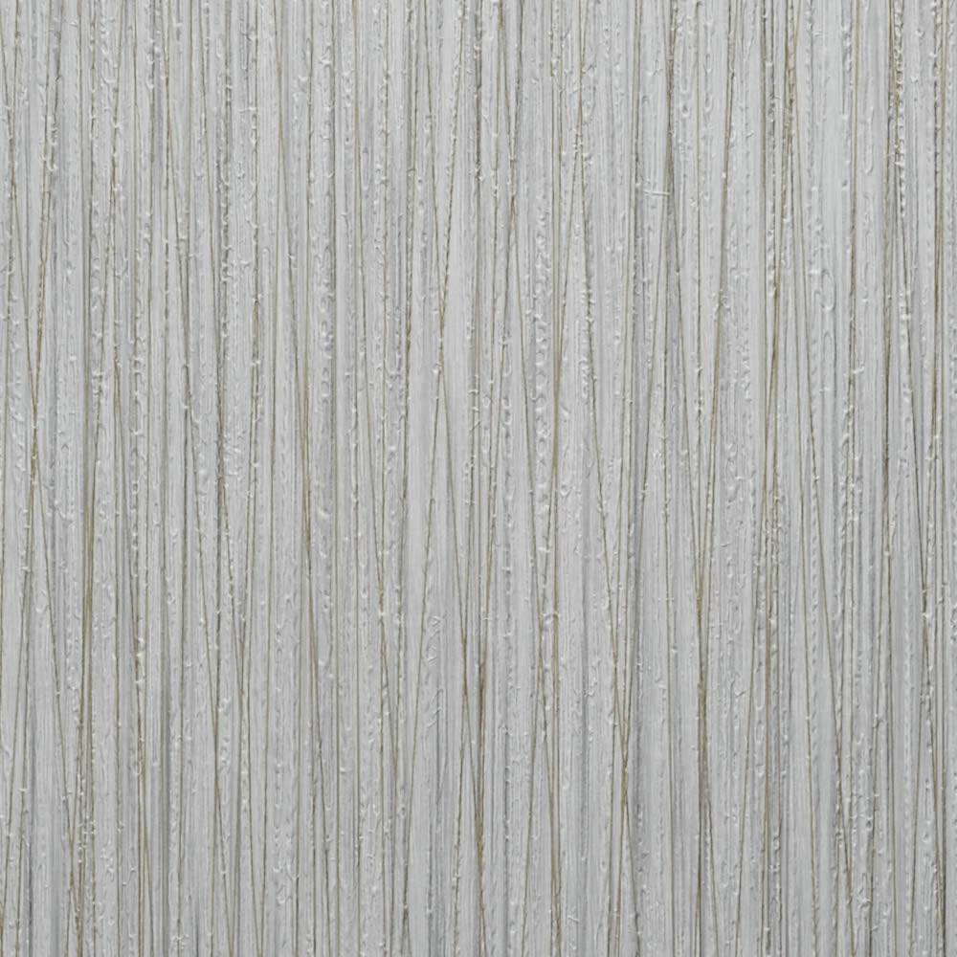
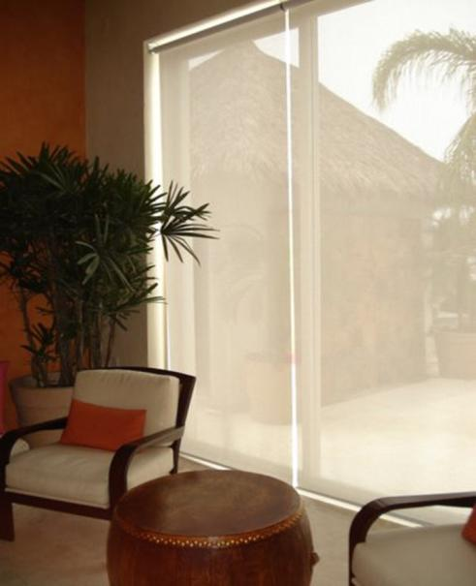
Alternative Plastic
For Textile & Coated Fabric Use
  • Custom tailored to the end use application
  • 0.89 to 1.00 specific gravity for flame retardant grades
  • Building block in bio-based versions
  in development
Recipient of R&D 100 Award from R&D
Magazine

Slide 9
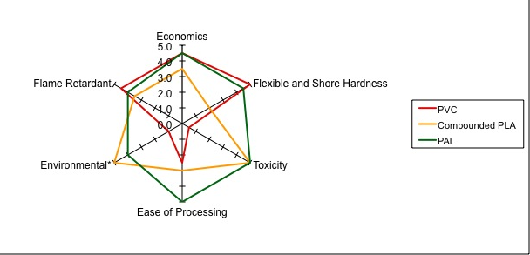
Property Comparison – Polymer Spider Chart
(PVC Alternative)

Slide 10

Sustainable Health
Does Not Contain Any Detectable:
    Phthalates
    Vinyl Chloride
    Heavy Metals
    Halogens/Bromine
    Dioxins
Can be used as a cradle to cradle offering:
  Recyclable – post-industrial/
  consumer waste
    Impact Modifier: Transportation products and pallets
    Interior uses where people gather.
    Sustainable

Slide 11

Sustainability Creed
Leave No Footprint Behind

Slide 12
More Applications of Alternative Compounds to Replace PVC
Practical end-uses
    Barrier Films, fibers, printed signage, labels and surface wraps
    Contract Fabrics: wall coverings, upholstery & nonwoven fabrics
    Coated fabrics, coated paper, films, Sheet, co-extrusions
    Barrier films, resilient flooring tiles, carpet, fibers
Common Processing Methods
    Extrusion / calendering / cast films / profiles
    Calendering/Injection Molding/Extrusion & Blown Films (FR only)/ Molded Products
Xxxxxxxxxx
xxxxxxxxxx.

Slide 13
Custom Compounds to Replace Flexible PVC
Compounds can include other specialty attributes:
  Examples: Color, UV resistance, Anti-microbial, Surface Modifiers, Flow Enhancers, etc. all tailored to the use processes and application.
Two distinct flame retardant systems used to provide a solution to replace flexible PVC while maintaining sustainability.
Vapor Phase FR’s: Commonly used flame retardant additives dispersed into the polymeric compound that inhibit combustion via chemically interfering with the combustion process. Vapor phase FR systems are either halogenated (brominated) or highly synergized brominated systems (very low bromine).
Intumescent: Flame retardant additives dispersed into the polymeric compound that inhibit combustion through the formation of a physical char layer. Often there are no flaming drips and higher levels of flame retardancy are possible meeting difficult FR specifications. 100% Non-Halogenated.
.

Slide 14
Recent Advances in the State-of- the-Art of Intumescent FR Systems
Various formulations to replace flexible PVC and other polymers for TODAYS market needs
  Flexible Intumescent Compounds used for:
    Commercial Wall Coverings, Technical Textiles, etc.
    Technical Textile Composite Constructions
  Stiff Compounds (Rigid Grades)
    Barrier moldings/sheeting, Partitions, O&G Platforms
  All of the above are non-toxic, low-smoke generation, non-halogenated and sustainable

Slide 15
Intumescent Adhesive/Lamination Grades
Composite Laminate Applications
  Sheet or film is formed from the Intumescent compound and sandwiched between woven carbon fiber or glass fabrics
  Calendaring is recommended as sheet/film formation process
    Excellent flame retardant properties of the sandwiched composites formed.
    Excellent adhesion of the intumescent compound to the carbon or glass fabrics.

Slide 16
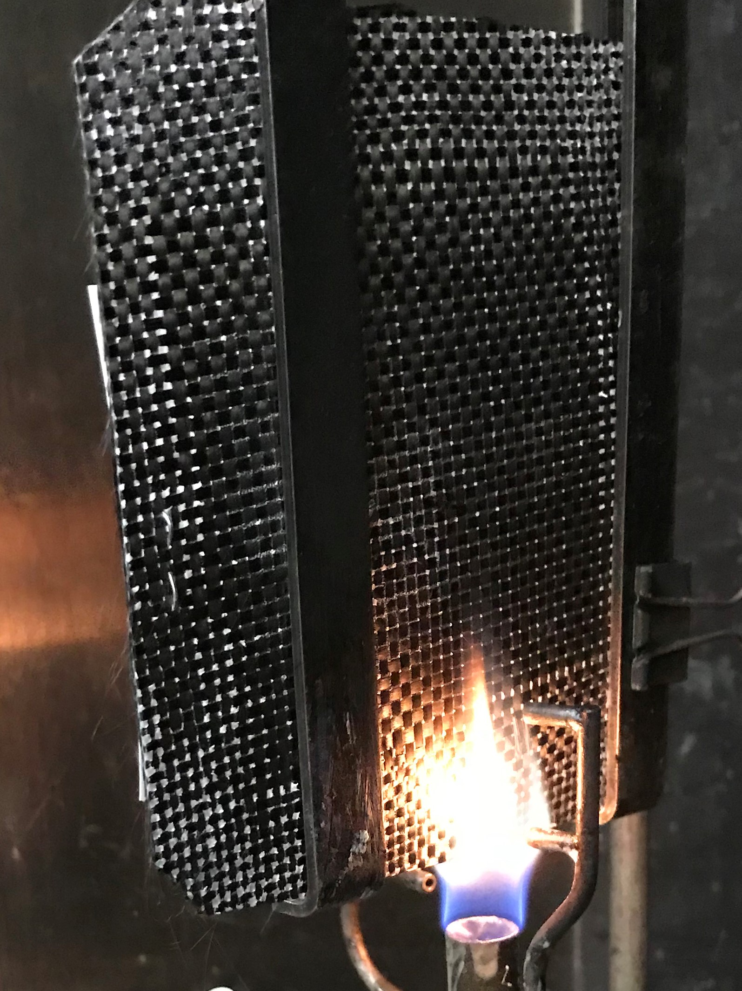
Woven Carbon Fiber & Glass Fabric Laminates
One Layer Intumescent Compound in center of the Sandwich (two layer fabric)
60 Second vertical burn
1,900 degree flame
Composite construction using extrusion lamination at the nip

Slide 17
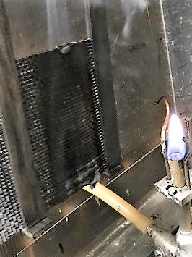
Post-Carbon Fiber / 60 sec. Burn

Slide 18
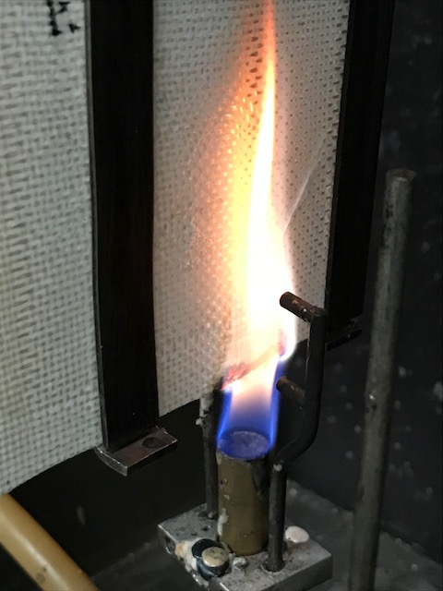
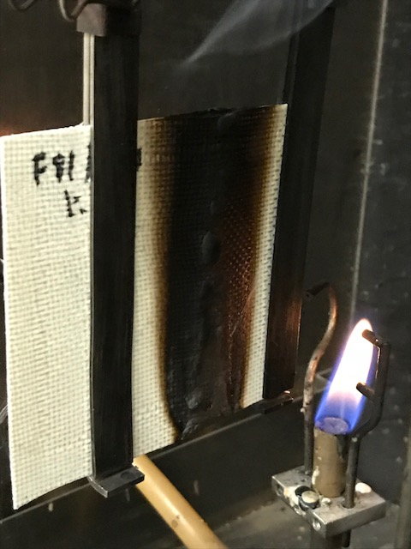
Intumescent /Glass - 60 sec. Burn

Slide 19
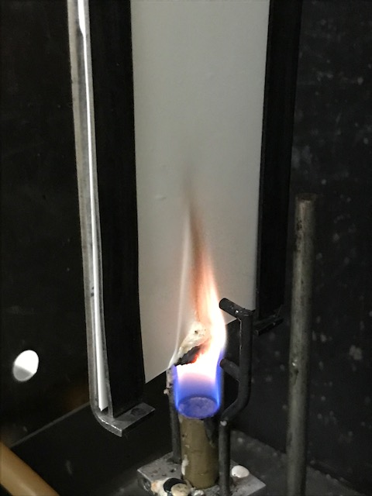
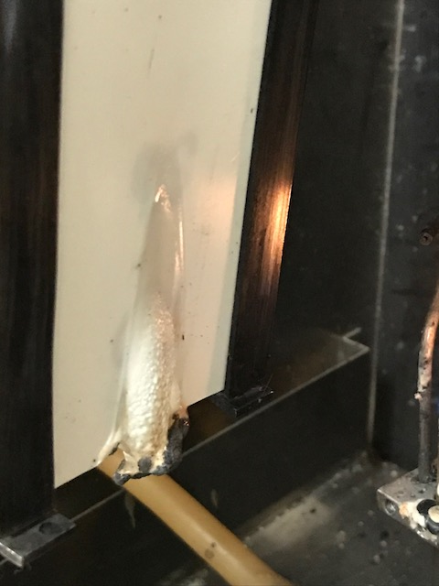
Intumescent Flexible Molded Plaque in 60 Sec. Vertical Burn

Slide 20
Key Takeaways
  State-of-the-art FR and Intumescent Compounds
  Both <Custom Tailorable> Rigid and Flexible Grades Available
  Cost Effective (< $5/lb.)
  Likely will pass more demanding FR specifications (e.g. Class “A” rating in Steiner Tunnel Test: ASTM E84 )
  Undetectable toxicity of combustion gases, low-smoke generation and sustainable
  Can be applied to multi-substrates: woven, paper, nonwovens
  Film, sheet and molded products are all possible with intumescent compounds
  Other properties easily formulated into intumescent compounds: Custom Colors, UV Resistance, Special Surface Properties, Anti-blocking Properties, Anti-microbial, and many other properties via additives/modifier additions.
  Many end-use commercial applications
    From interiors and building exteriors, where people gather and protection of valuable assets.
      e.g. offices, schools, theaters. churches, hospitals, aircraft, casinos, malls, busses/rail, restaurants, hotels, arenas

Slide 21



Slide 22
Thank you for your attention
Edward C. Gregor
Managing Director
Edward C. Gregor & Associates, LLC

